Slide 1
Mortgage Default
Team 10
Avinita Shetty
Vishwa Shah
Jun Wu

Slide 2
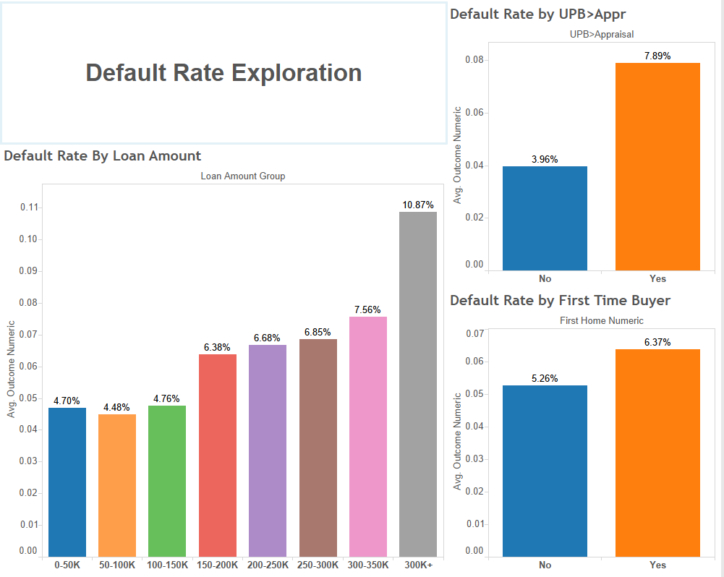
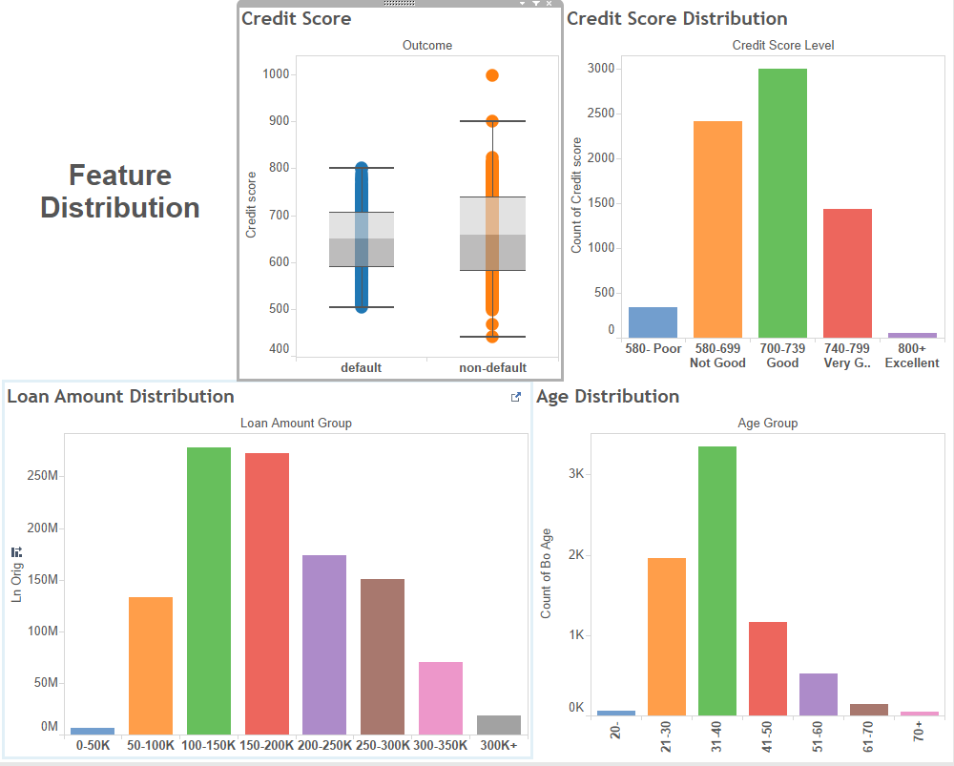
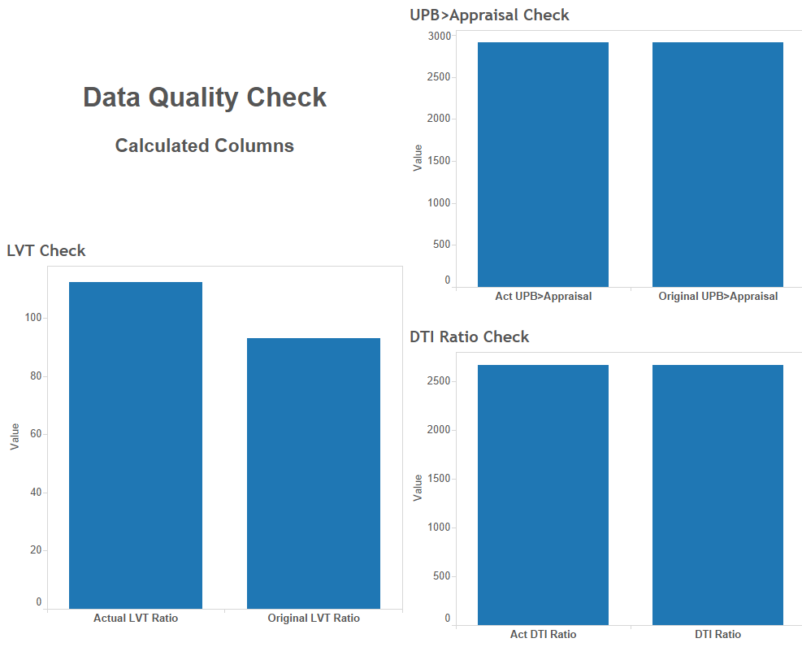
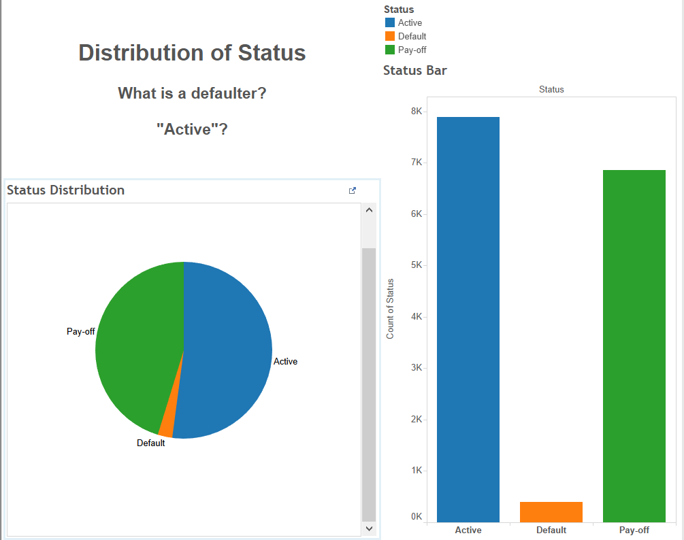
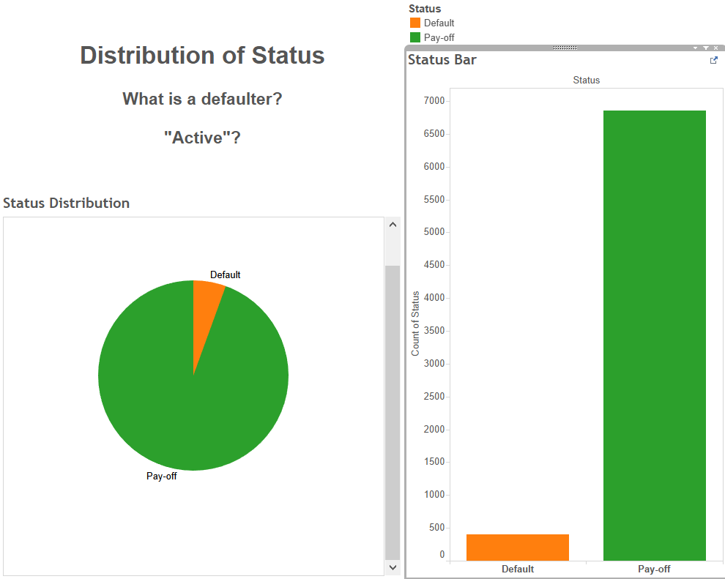
2.1 Exploratory data analysis
Misidentified group:
Active?
Data Quality Check:
Calculated correctly?
Outliers?
Distribution Analysis
By features? By Geography?
KPI
Default Rate

Slide 3
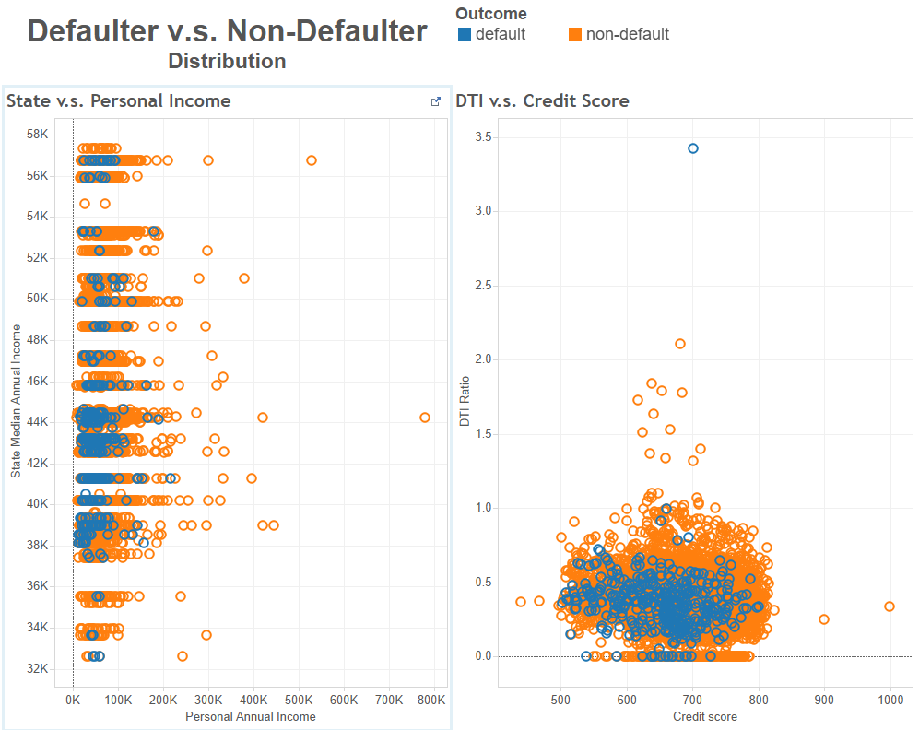
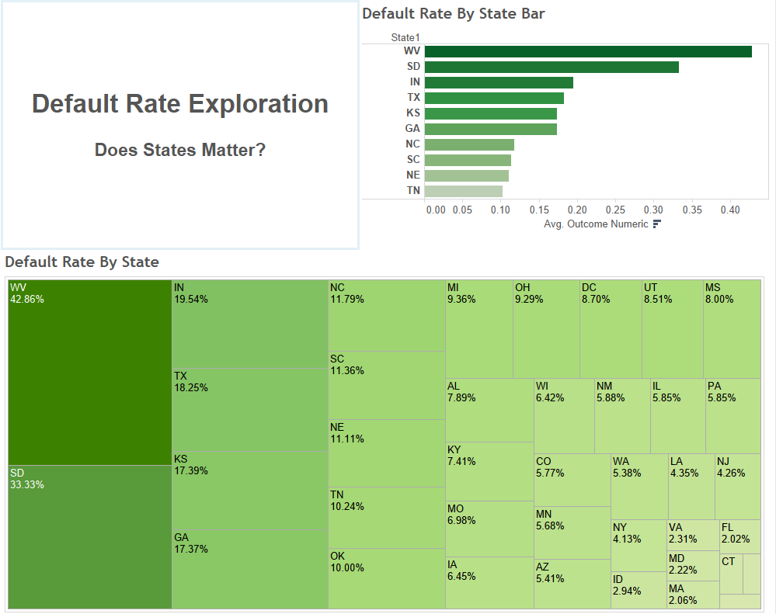
2.2 Classification Models
Preprocessing
Bye-bye “Active”/ “Status”, “State”
Give me real “LVT”
Yes/No, Default/nondefault -> 1/0
Credit Score 999! Really?!
Data Partition
60 Training, 40 Testing
Modeling:
Logistic Regression, CART, Random Forest
Cut-off point: 0.05538
Why? I tell you…

Slide 4
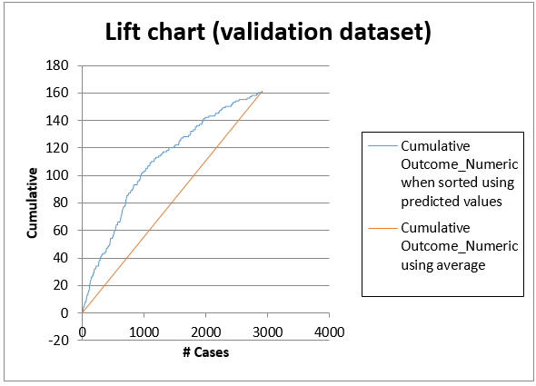
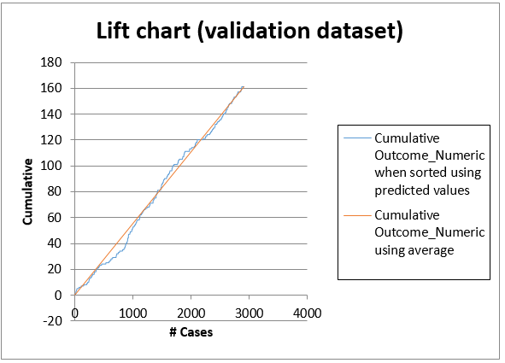
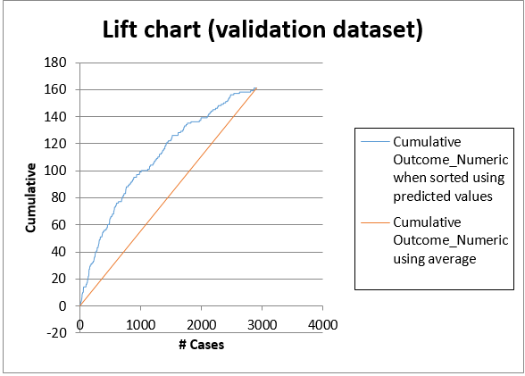
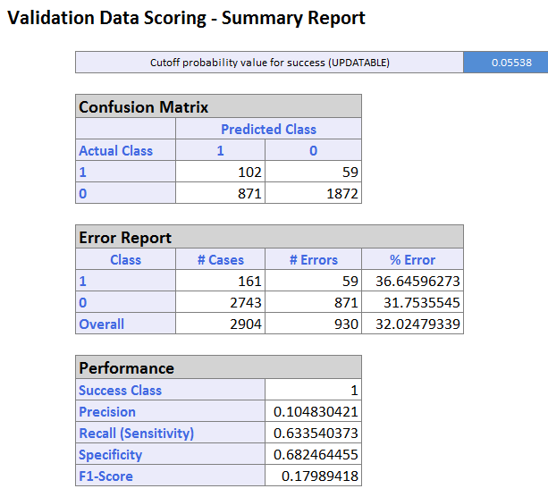
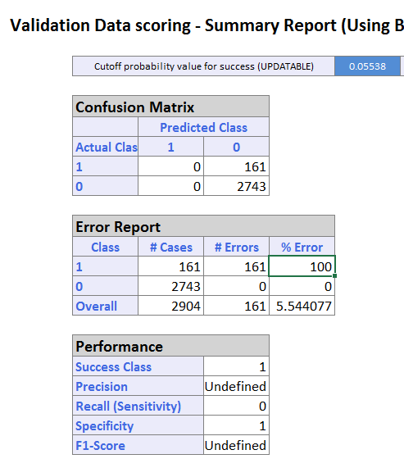
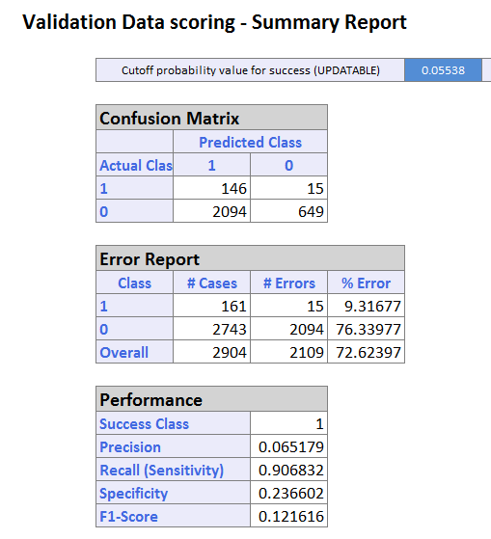
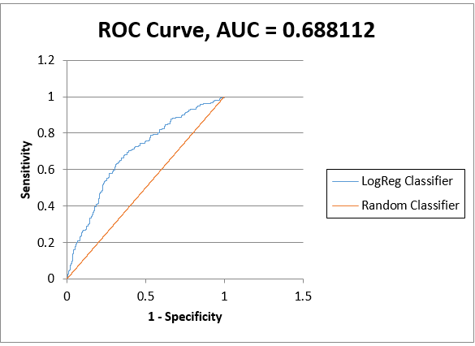
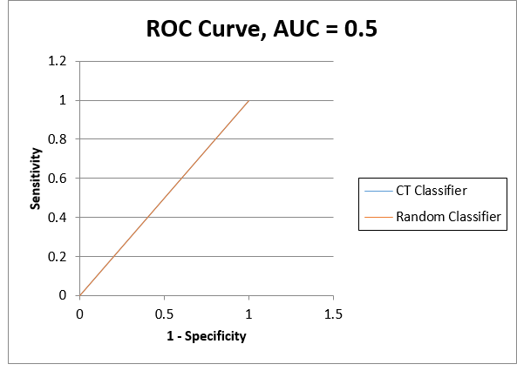
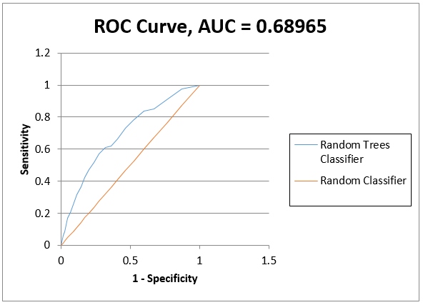
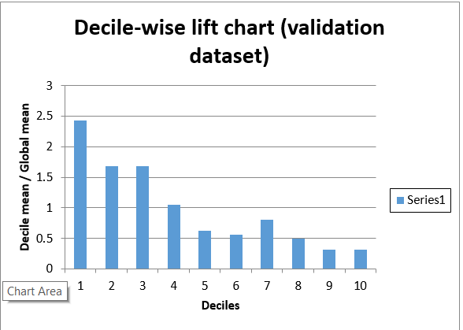
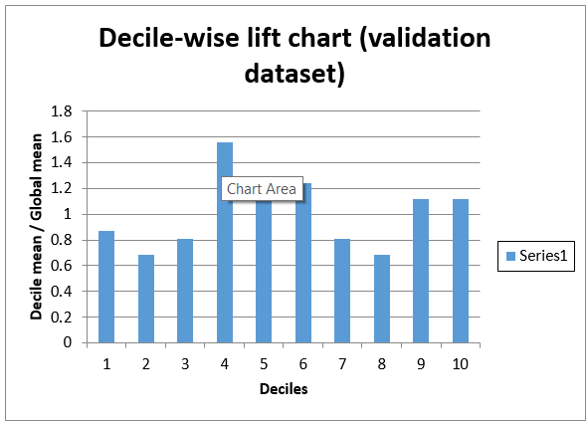
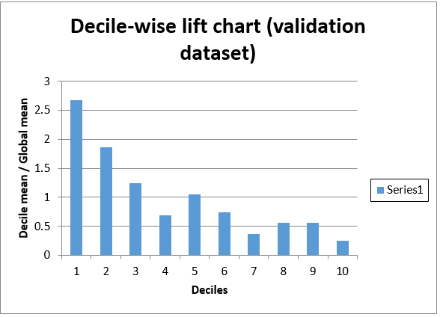
2.3 Performance evaluation
Matrix, Error Rate
Lift Chart
ROC Curve
CART! What!? No..

Slide 5
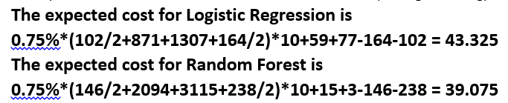
2.4 Model selection & recommendation
Why are we doing this?
Marginal cost
Who is more important?
You! Defaulter!
How much does it cost?
Expected cost
Can we do better?
Boosting? Trimming? Others?
Keep training, keep learning.

